Slide 1

Hotel Booking System

Slide 2
Technologies
Java
JDBC
Hibernate
MYSQL
Maven

Slide 3
Problem Statement
Customers should be able to register for an account with their personal details.
Registered customers should be able to log in securely using their credentials.
Allow customers to search for available rooms based on their preferences and book them for specific dates.
Calculate the total cost of reservations based on room rates and duration of stay.
Admin can add/modify/view/remove rooms type, rates.
Admin can modify/view/remove reservation.

Slide 4
Plan
Design
Generate the skeleton as per class design provided
TDD approach
Identify test cases for each module
Write Failing Test cases
Convert the Test Cases in GREEN
Implement the case study in incremental manner

Slide 5
Modules
Register
Module
Login
Module
Booking
module
Payment
Module
Admin
Module

Slide 6
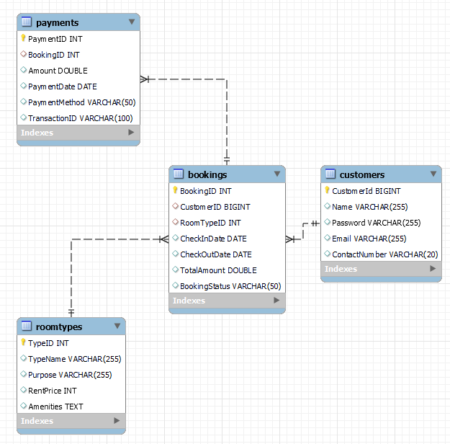
Class Design [Schema]

Slide 7
Class Design [ Service Interface]
BookingsDao
void saveBooking(Bookings booking); void deleteBooking(int bookingID); void updateBooking(Bookings booking); Bookings getBookingById(int bookingId);
CustomerDao
void addCustomer(Customer customer); Customer getCustomerByEmail(String email); List<Customer> getAllCustomers();
PaymentsDao
void addPayment(Payments payment); List<Payments> getAllPayments(); Payments getPaymentById(int paymentID); void updatePayment(Payments payment); void deletePayment(int paymentID);
RoomTypesDao
void addRoomType(Scanner scanner); List<RoomTypes> readAllRoomTypes(); void updateRoomType(Scanner scanner); void deleteRoomType(Scanner scanner); RoomTypes getRoomTypeById(int typeId);

Slide 8
Class Design [Repository]
BookingsDaoImpl
void saveBooking(Bookings booking); void deleteBooking(int bookingID); void updateBooking(Bookings booking); Bookings getBookingById(int bookingId);
CustomerDAOImpl
void addCustomer(Customer customer); Customer getCustomerByEmail(String email); List<Customer> getAllCustomers();
PaymentsDaoImpl
void addPayment(Payments payment); List<Payments> getAllPayments(); Payments getPaymentById(int paymentID); void updatePayment(Payments payment); void deletePayment(int paymentID);
RoomTypesDaoImpl
void addRoomType(Scanner scanner); List<RoomTypes> readAllRoomTypes(); void updateRoomType(Scanner scanner); void deleteRoomType(Scanner scanner); RoomTypes getRoomTypeById(int typeId);

